Slide 1
The Infinity Board
By: Jake Asmus, Joseph Brown, Daniel Peterjohn, and Jiangning Xiong

Slide 2
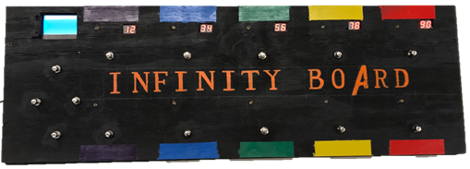
The Line Up
The Problem Statement | Currently | Our Solution | Terminology | Software Design | Hardware Design
The Problem Statement
Currently
Our Solution
Terminology
Software Design
Hardware Design
Demo
Questions

Slide 3
The Problem Statement
The Problem Statement | Currently | Our Solution | Terminology | Software Design | Hardware Design
Asked for a new sound effect device with multiple effects and/or a different way to interact with musicians live
Our team decided to tackle both problems and allow as much flexibility as possible for the musician

Slide 4
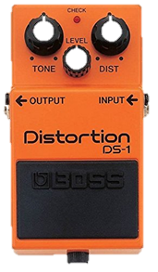
What is a Pedal?
The Problem Statement | Currently | Our Solution | Terminology | Software Design | Hardware Design
To the right is an example of a typical guitar pedal

Slide 5
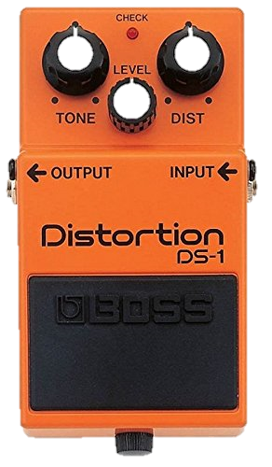
What is a Pedal Board?
The Problem Statement | Currently | Our Solution | Terminology | Software Design | Hardware Design

Slide 6
Our Solution
The Problem Statement | Currently | Our Solution | Terminology | Software Design | Hardware Design
Multiple Sound Options:
Multiple Effects from one input to two outputs
One output will be the original signal, unchanged
The other output will be the effect signal
Allowing the user to maximize/diversify their sound and musical options
Unique User Interface:
The pedal board that can do it all
Rearranging the effects on the board, wirelessly and painlessly
The “knob” values can be adjusted for each effect in the pedal board
Quicker, easier, and more accurate adjustments in a live setting

Slide 7
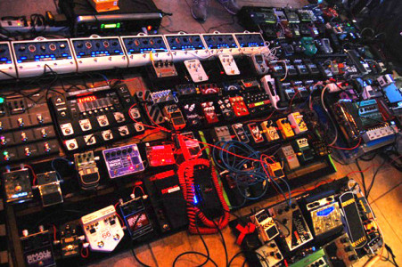
Infinity Board – Broad Scale Idea
The Problem Statement | Currently | Our Solution | Terminology | Software Design | Hardware Design
Have “n” pedal effects
Sequence “n” pedal effects

Slide 8
Infinity Board – Small Scale Implementation
The Problem Statement | Currently | Our Solution | Terminology | Software Design | Hardware Design
Effect List:
1: PassThrough
2: Chorus
3: Reverb
4: Flange
5: BitCrusher
For the Project
5 Pedal Effects
Sequence 3 Pedal Effects
Audio Output 1
Audio In
Current Effect:
Flange
Current Effect:
Bitcrusher
Current Effect:
Chorus
Audio Output 2

Slide 9
Terminology

Slide 10
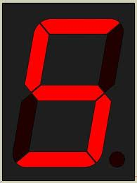
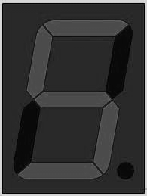
Design Overview
The Problem Statement | Currently | Our Solution | Terminology | Software Design | Hardware Design
Performance
*Pedal Adjustments*
E0: Chorus
E1: BitCrusher
E2: Flange

Slide 11
Columns and Cells
The Problem Statement | Currently | Our Solution | Terminology | Software Design | Hardware Design
Column 0
Column 1
Top Row
CELL 0
CELL 2
Bottom Row
CELL 1
CELL 3

Slide 12
Toggle Mode
The Problem Statement | Currently | Our Solution | Terminology | Software Design | Hardware Design
State Indicator
Green for “On”
Number display turn off (Unused)
Red for “Off”
Buttons are assigned to separate functionalities

Slide 13
Knob Mode
The Problem Statement | Currently | Our Solution | Terminology | Software Design | Hardware Design
Number display turned on
LEDs turn off (Unused)
“Increase”
Column of buttons is “Linked”
“Decrease”

Slide 14
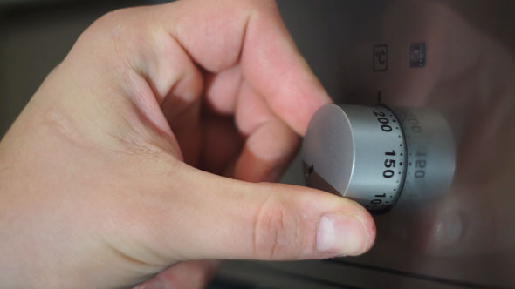
Knob Mode: Why?
The Problem Statement | Currently | Our Solution | Terminology | Software Design | Hardware Design
Using Hand
The WHY?
Using Foot
+1or +2 if held
Increase
Column is “Linked”
Decrease
-1or -2 if held

Slide 15
Software Design

Slide 16
Teensy Audio Library
The Problem Statement | Currently | Our Solution | Terminology | Software Design | Hardware Design

Slide 17
Teensy Audio Library
The Problem Statement | Currently | Our Solution | Terminology | Software Design | Hardware Design

Slide 18
Effect Pipeline Diagram
The Problem Statement | Currently | Our Solution | Terminology | Software Design | Hardware Design
Audio Output 1
Effect Pipe 2
Effect Pipe 1
Effect Pipe 0
Audio In
Current Effect:
Flange
Current Effect:
Bitcrusher
Current Effect:
Chorus
Audio Output 2

Slide 19
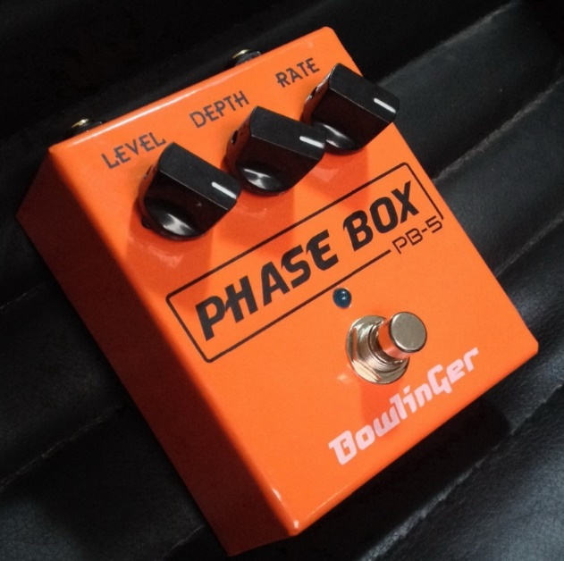
Pedal Effect Mapping Example
The Problem Statement | Currently | Our Solution | Terminology | Software Design | Hardware Design
D
D
C
B
C
A
B
Performance
*Pedal Adjustments*
E0: Chorus
E1: BitCrusher
E2: Flange
A

Slide 20
Page Switching
The Problem Statement | Currently | Our Solution | Terminology | Software Design | Hardware Design
Performance
*Pedal Adjustments*
E0: Chorus
E1: BitCrusher
E2: Flange
E2
E1
E0
E1 Volume
E1
Voice Knob Effect
Sample Rate
E0 Volume
Number Bits

Slide 21
Hardware Design

Slide 22
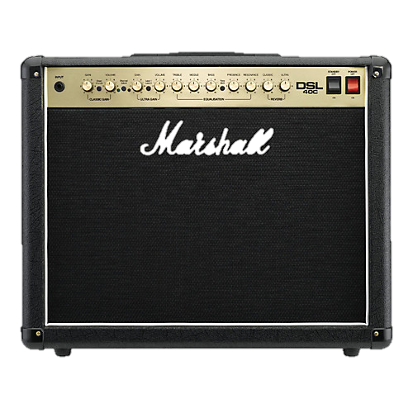
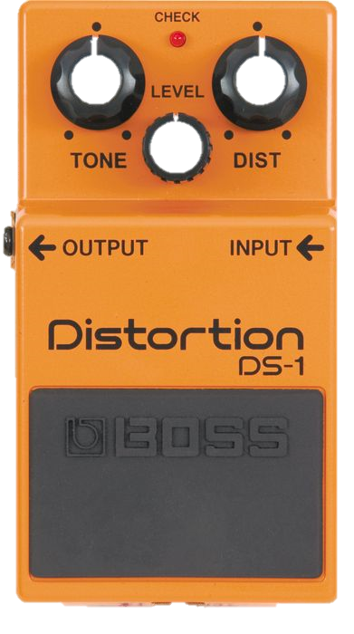
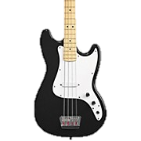
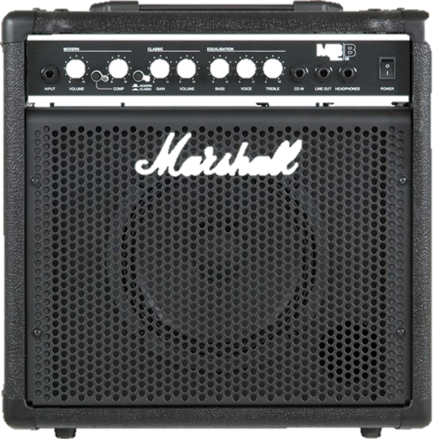
The Old Plan
The Problem Statement | Currently | Our Solution | Terminology | Software Design | Hardware Design
Digital Communication
Audio Signal
Our Effect Pedal
Other Effect Pedal
Amplifiers
Instrument
Our Pedal Mat

Slide 23
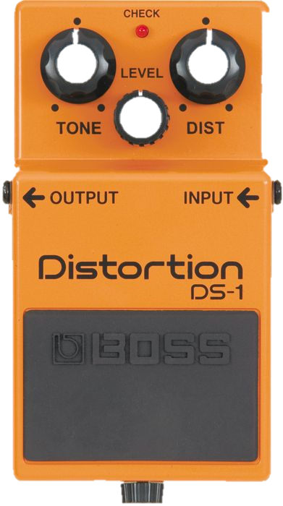
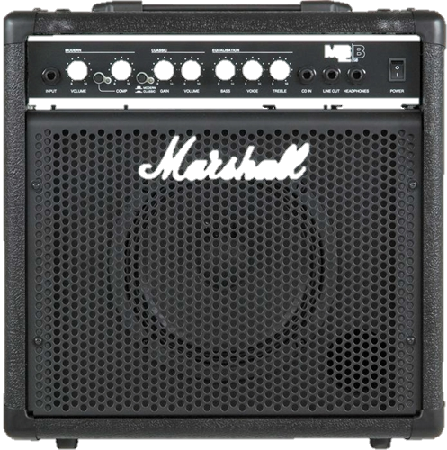
The New Plan
The Problem Statement | Currently | Our Solution | Terminology | Software Design | Hardware Design
Audio Signal
Effected Signal
Other Effect Pedal
Amplifiers
Our Pedal Board
Pass Through
Signal
Instrument

Slide 24
Hardware Diagram
The Problem Statement | Currently | Our Solution | Terminology | Software Design | Hardware Design
Audio Out 2
Teensy
Audio In
Audio Out 1
Register
(SIPO)
Register
(PISO)
Register
(SIPO)
LED Driver
Data Driver
Seven-Segment
Driver

Slide 25
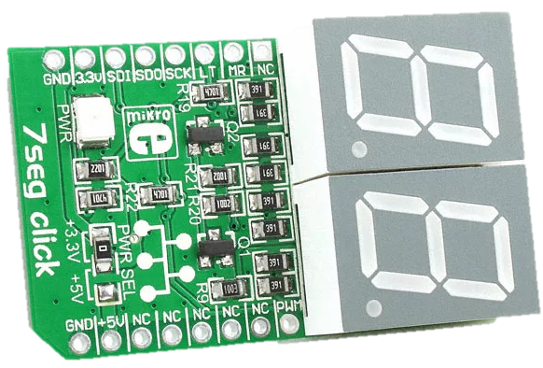
Seven-Segment Driver Hardware
The Problem Statement | Currently | Our Solution | Terminology | Software Design | Hardware Design
Register
(SIPO)
5 Seven-Seg PCB for the Infinity Board
Made the main PCB much smaller
Just uses data inputs
Seven-Segment
Driver

Slide 26
Infinity Board Hardware Diagram
The Problem Statement | Currently | Our Solution | Terminology | Software Design | Hardware Design
Audio Out 2
Teensy
Audio In
Audio Out 1
Register
(SIPO)
Register
(PISO)
Register
(SIPO)
LED Driver
Data Driver
Seven-Segment
Driver

Slide 27
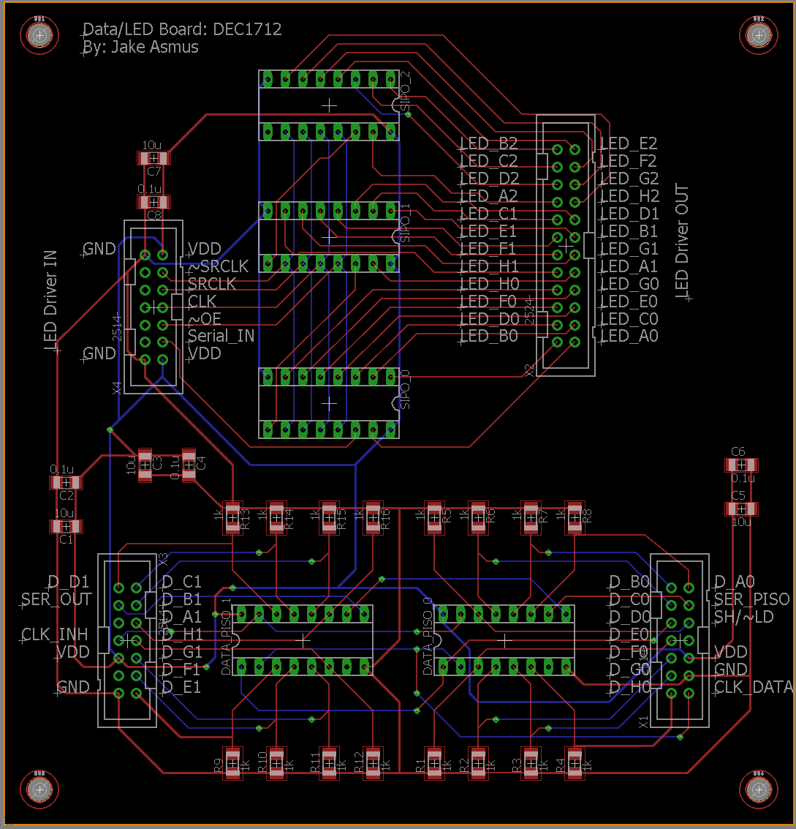
Data and LED Driver Hardware
The Problem Statement | Currently | Our Solution | Terminology | Software Design | Hardware Design
Register
(SIPO)
Register
(PISO)
Teensy Reads Data Registers
Teensy Processes data
LED Driver
Data Driver
Sends data to LED Driver
Sends data to Seven-Seg Driver

Slide 28
Infinity Board Hardware Diagram
The Problem Statement | Currently | Our Solution | Terminology | Software Design | Hardware Design
Audio Out 2
Teensy
Audio In
Audio Out 1
Register
(SIPO)
Register
(PISO)
Register
(SIPO)
LED Driver
Data Driver
Seven-Segment
Driver

Slide 29
Semester 1 Project Semester 2 Project
The Problem Statement | Currently | Our Solution | Terminology | Software Design | Hardware Design

Slide 30
Demo Time!!!

Slide 31
Questions?
The Problem Statement | Currently | Our Solution | Terminology | Software Design | The Infinity Board Design

